Slide 1


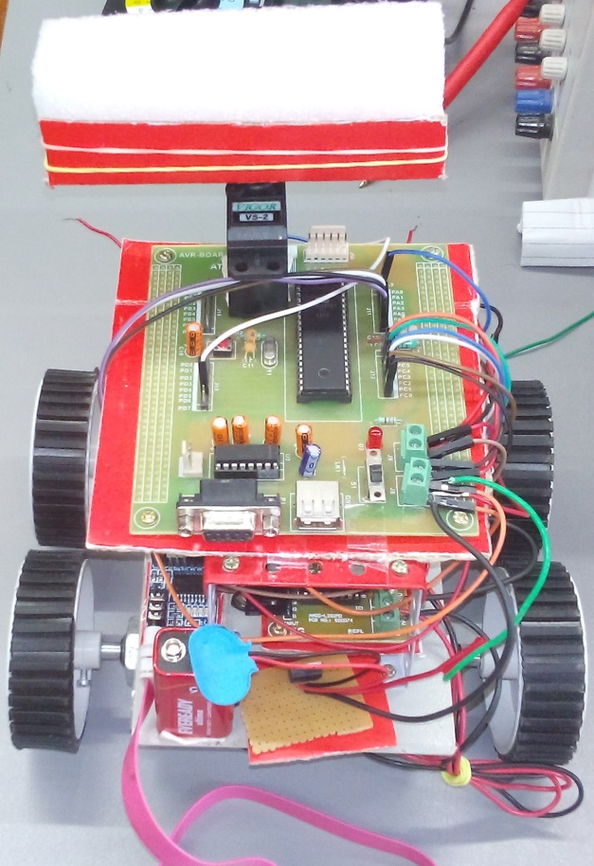
Wi - Robot Ashutosh Kakadiya, Deep Talati, Harsh Mehta, Kishan Raval
IET
INSTITUTE OF ENGINEERING & TECHNOLOGY
￼
Application:
Net surveillance through Web application from any place
Controlling a Robot from remote place
Learnings:
Basic construction of robot
DC & Servo Motor interfacing
Infra-Red sensor interfacing
ATMEGA32 programming
Programming for changing angle of Servo motor
Dual Tone Multi Frequency (DTMF) decoder interfacing

